Slide 1
EMPLOYEE MANAGEMENT SYSTEM
By
Praveen M Suwathi T

Slide 2
EMS
Employee Management System is a distributed application developed to maintain their details of employees working in any organization.
It maintain the information about the personal and official details of the employees

Slide 3
EXISTING SYTEM
Earlier systems were manual where there was no way of properly storing information. Employee records were stored manually which lead to errors. There was no proper way of tracking employee records. It was very difficult and required a lot of paperwork which makes the application time consuming and not secured. There was no administrator which could handle the records. So there was the need to develop a system which could manage all these things and reduce the paperwork.

Slide 4
PROPOSED SYSTEM
Employee information system is easy to use application which is created to manage the employee data. It is created to record the details of the employees. This reduces the dependency on the manual system which could create errors. This system can easily help in tracking employee records. There is a search feature which allows getting records of a specific employee. There is an administrator which can add, edit, delete and save records in a database. There are two views for this application first is the administrator and the second is employee view. The employee view enables employees to view their details.

Slide 5
TECHNOLOGY USED
Spring Boot
Hibernate
JPA
MySql
Language:Java

Slide 6
SPRING BOOT
Spring boot is an open source Java-based framework used to create a micro-services.
Spring Boot provides a good platform for Java developers to develop a stand-alone and production-grade spring application that you can just run.
Eases dependency management

Slide 7
HIBERNATE
Hibernate is a JPA provider.
It understands the mapping that we add between objects and tables.
It ensures that data is stored/retrieved from the database based on the mappings

Slide 8
MODULES
Admin Login
Create
Update
Delete
Search
User Login
View Details

Slide 9
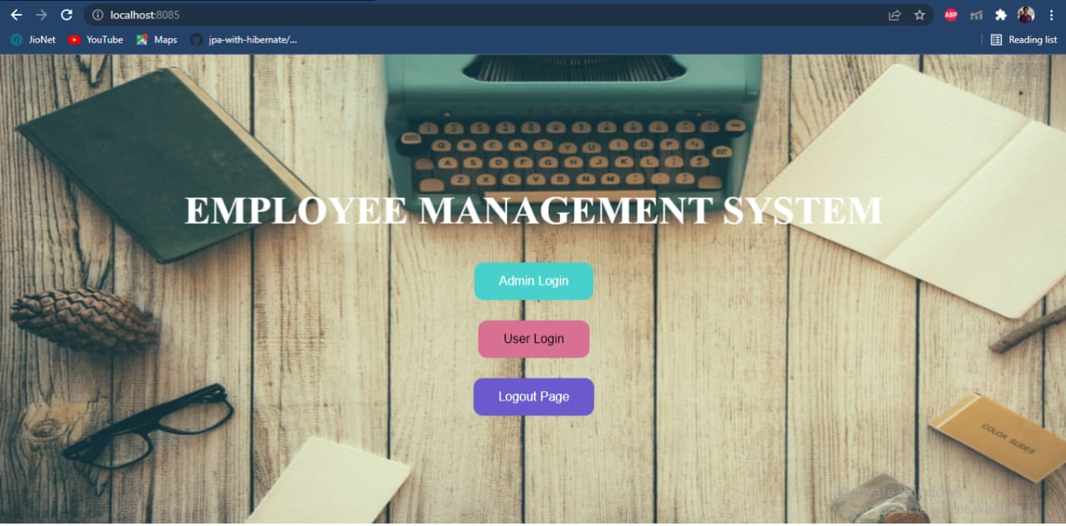

Slide 10
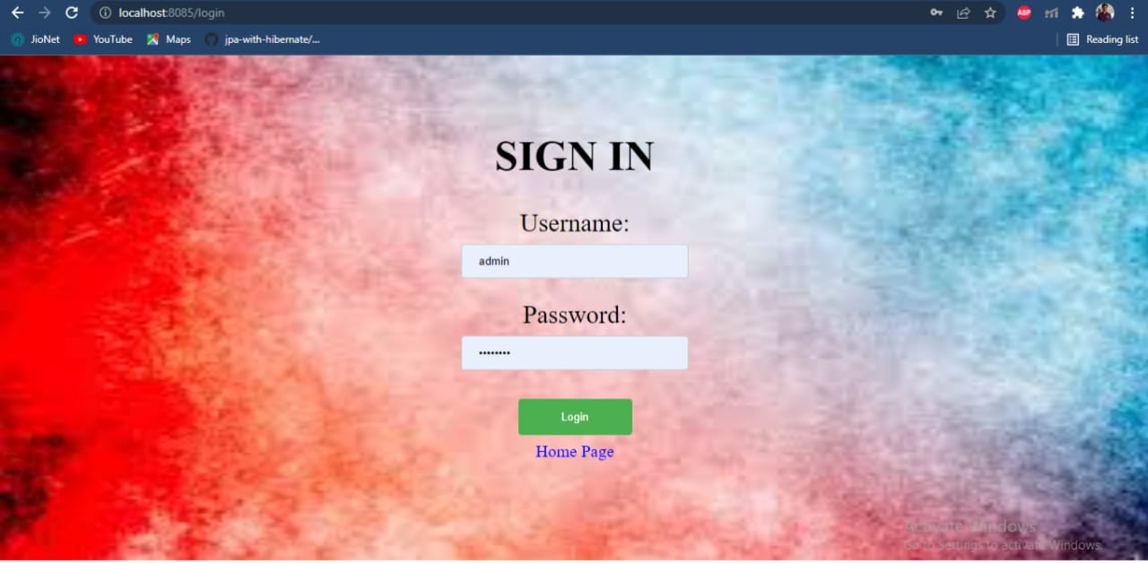

Slide 11
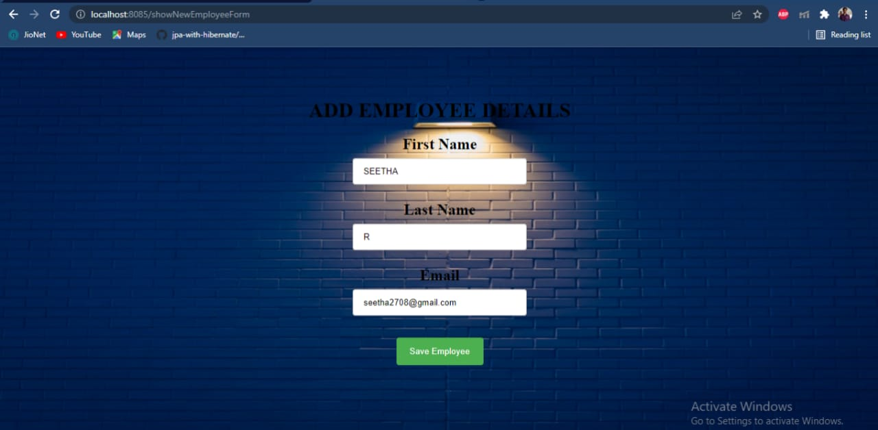

Slide 12
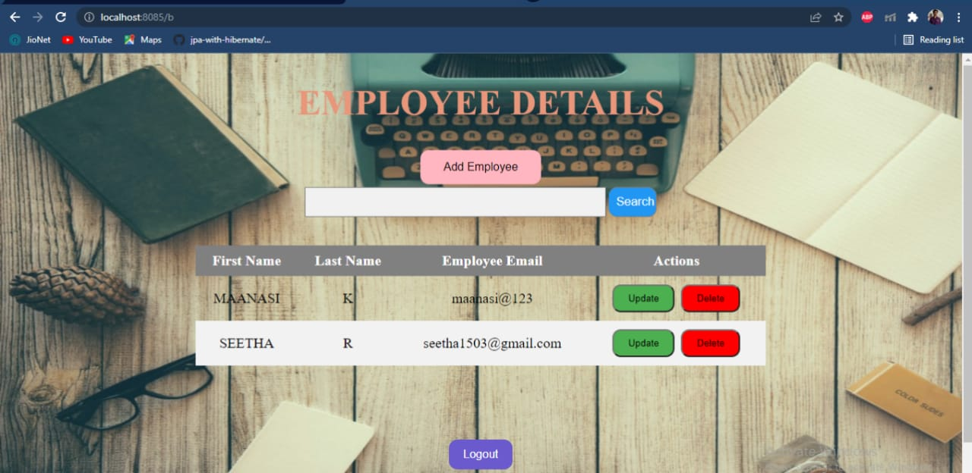

Slide 13
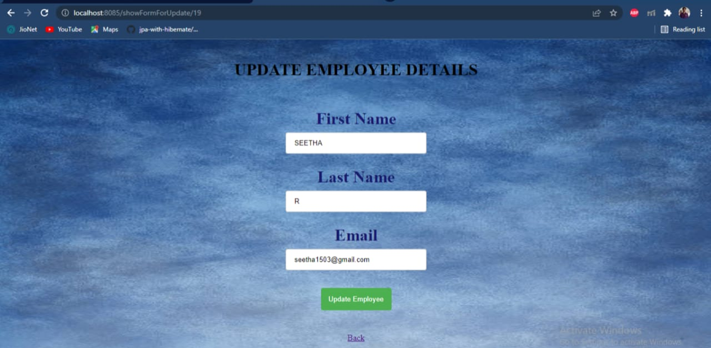

Slide 14
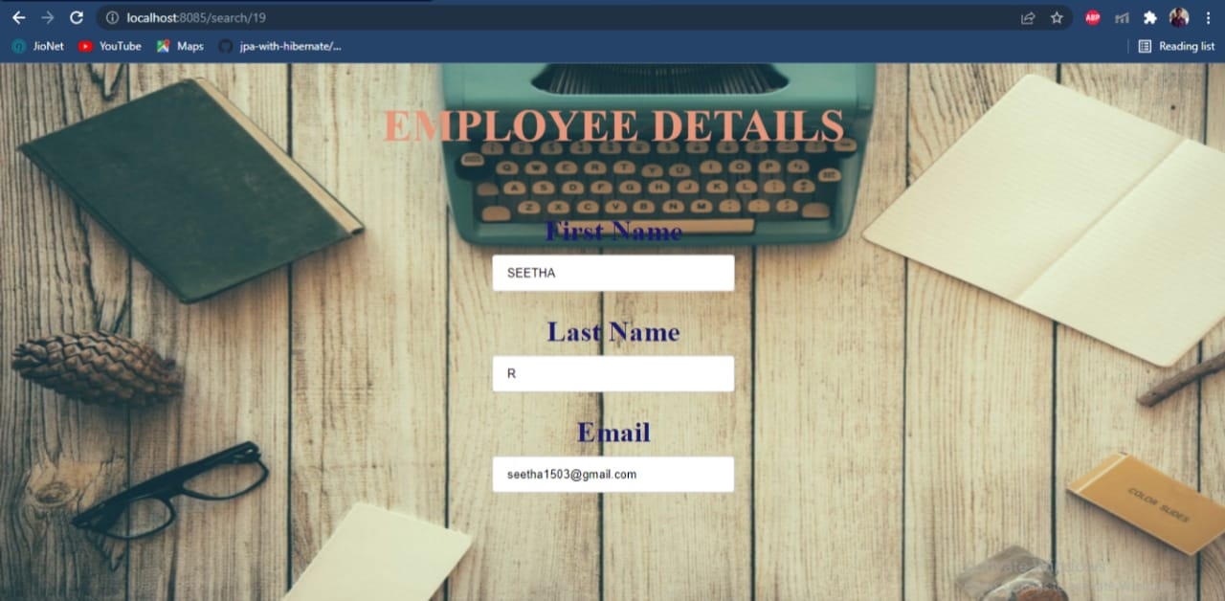

Slide 15
THANK YOU

